Slide 1
HTML Text Formatting with Logical Style Tags

Slide 2
In HTML, the logical style tags specify that the enclosed text has a specific meaning, context, or usage. For example, the ABBR tag conveys to the Web browser that the text enclosed inside this tag is an abbreviation. The browser change the appearance of the text depending upon the meaning of the tags.
The advantage of using the logical style tags rather than the physical style tags is that the meaning related to the tag is more precisely conveyed to the users

Slide 3
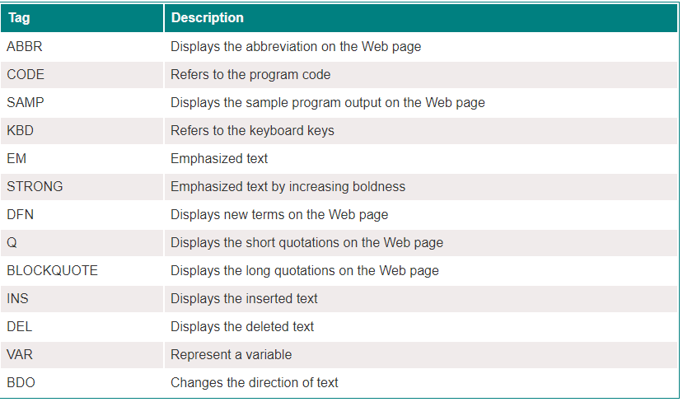

Slide 4
The <strong> Tag
Sometimes you need to lay more emphasis on some part of your paragraph. Browsers by default render anything inside a <strong> tag as bold text.
Example:-- <p> Hi there! My name is <strong>Isha</strong></p>
The <em> Tag
Just like the <strong>, the <em> tag is also used to lay emphasis on certain text within a paragraph.However, instead of making the text bold, browsers render content inside the <em> tag as italics.

Slide 5
<abbr> tag
The <abbr> tag is used to represent an abbreviation or acronym. The tag accepts a title attribute that accepts the full form of the word. When the reader hovers the text it shows a full description of the word.

Slide 6
<q> tag
The <q> tag defines an inline quotation. The most modern browser automatically adds quotation marks around the text.
<p>The concept of <q>this</q> in javascript may be a little confusing to beginners.</p>
<bdo> Tag
HTML <bdo> tag specifies text direction to a display. tag is useful when displaying Arabic language.

Slide 7
<dfn> tag
The <dfn> tag (definition tag) is used to tell that a term is being defined in the sentence.
<p><dfn>HTML</dfn> is a markup language used to create web pages.</p>
<CODE> tag
The HTML CODE tag is used to represent the computer code in an HTML document. So if you want to display some article on the Web page, which contains some text and code of a program, then you can write the program code within the CODE tag so that the reader of the article can differentiate between the normal text and the code.

Slide 8
<html>
<head>
<title>HTML Text Formatting with Logical Style Tags Example</title>
</head>
<body>
<p>This is <code>code</code> text.</p>
</body>
</html

Slide 9
<blockquote> tag
specifies a section that is quoted from another source.
<!DOCTYPE html>
<html>
<body>
<h1>The blockquote element</h1>
<p>Here is a quote from a website:</p>
<blockquote cite="https://www.simplilearn.com/tutorials/data-science-tutorial/what-is-data-science">
Data science is the domain of study that deals with vast volumes of data using modern tools and techniques to find unseen patterns, derive meaningful information, and make business decisions.
</blockquote>
</body>
</html>

Slide 10
<ins> tag
defines a text that has been inserted into a document. Browsers will usually underline inserted text.
<del> tag
defines text that has been deleted from a document. Browsers will usually strike a line through deleted text.
Eg:
<p>My favorite is is <del>tea</del> <ins>coffee</ins>!</p>

Slide 11
<kbd> tag
is used to define keyboard input. The content inside is displayed in the browser's default monospace font.
Eg:<p>Press <kbd>Ctrl</kbd> + <kbd>C</kbd> to copy text (Windows).</p> <p>Press <kbd>Cmd</kbd> + <kbd>C</kbd> to copy text (Mac OS).</p>

Slide 12
<var> tag
is used to defines a variable in programming or in a mathematical expression. The content inside is typically displayed in italic.
<p>The equation for any straight line can be expressed in the formula: <var>y</var> = <var>mx</var> + <var>b</var>.</p>

Slide 13
Formatting text with HTML physical style elements

Slide 14
HTML uses physical style tags to change the appearance of text. If you want your text to appear in a particular style such as bold or italics etc., you must use physical style tags. For example to ensure that text appear in small font, then you must enclose it between starting and ending tags of the SMALL tag.

Slide 15
<sub> tag
is used to display text as a subscript Eg:
<p>The molecular formula of glucose is C<sub>6</sub>H<sub>12</sub>O<sub>6</sub>.</p>
Sup :
To display text as superscript
Eg: <p> 2 is the superscript on e<sup>2</sup></p>

Slide 16
<small> tag
defines smaller text (like copyright and other side-comments).
Eg:
<p>This is some normal text.</p> <p><small>This is some smaller text.</small></p>

